Slide 1
Deploying a wordpress website using azure
Mentor: Dr.viveswaran
Team Name: Teamalpha
-by
Shrinithi S(19EUEC141)
Sneha M(19EUEC146)

Slide 2
ABSTRACT:
Cloud platform services are domineering now-a-days mainly s-a-a-s, since the requires least management
Pay-as-you-go pricing model , increases optimized use of resources
Azure is one of the leading cloud platforms owned by Microsoft
Deploying a wordpress website is one of the simple example of its resources
This Project is a result of learning and testing the features of Azure Cloud wherein we have grasped knowledge about virtual machines,v-net,subnet,nsg,image etc,..
Keywords: Resource group ,Hybrid cloud,VM, wordpress web, deployment

Slide 3
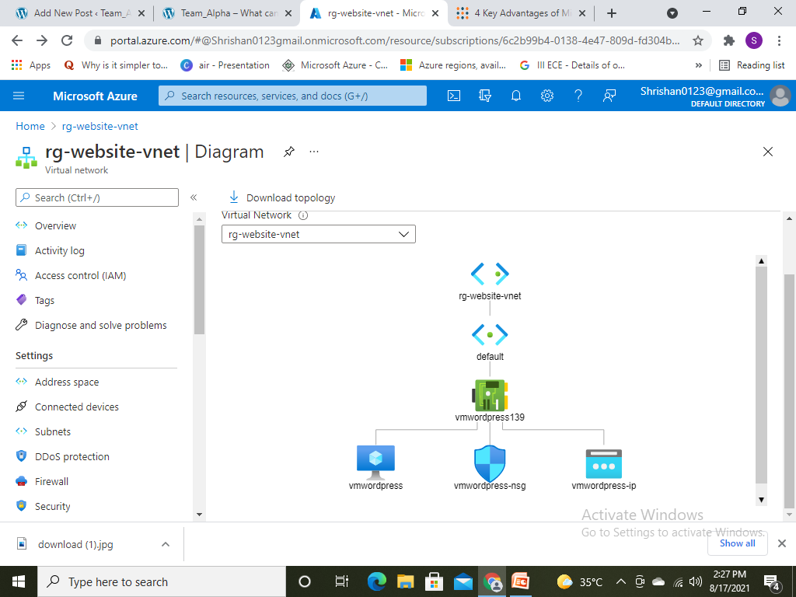
Block diagram

Slide 4
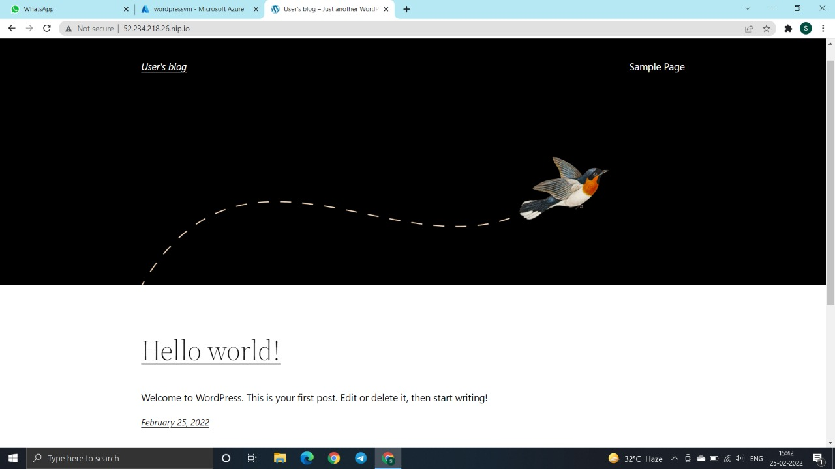
WEBSITE LINK
http://52.234.218.26.nip.io/

Slide 5
TECH STACK
AZURE portal
Wordpress by bitnami VM
Resource Group
- vnet
-vnet bastion
-vnet-ip
-wordpress vm
-Wordpress ip
-wordpress nsg
-wordpress vm 330(interface)
-wordpress OS disk

Slide 6
WORKING
Create resource group→ wordpress vm→boot diagnostics→serial log→password (wp-admin)
Wordpress website – Network Admin and User blog
Users- Super-Admin & other users (add new)
Media,library,all page,add page
Dashboard
-site health status
–recent activity
–quick draft
–at a glance
-wordpress events and news

Slide 7
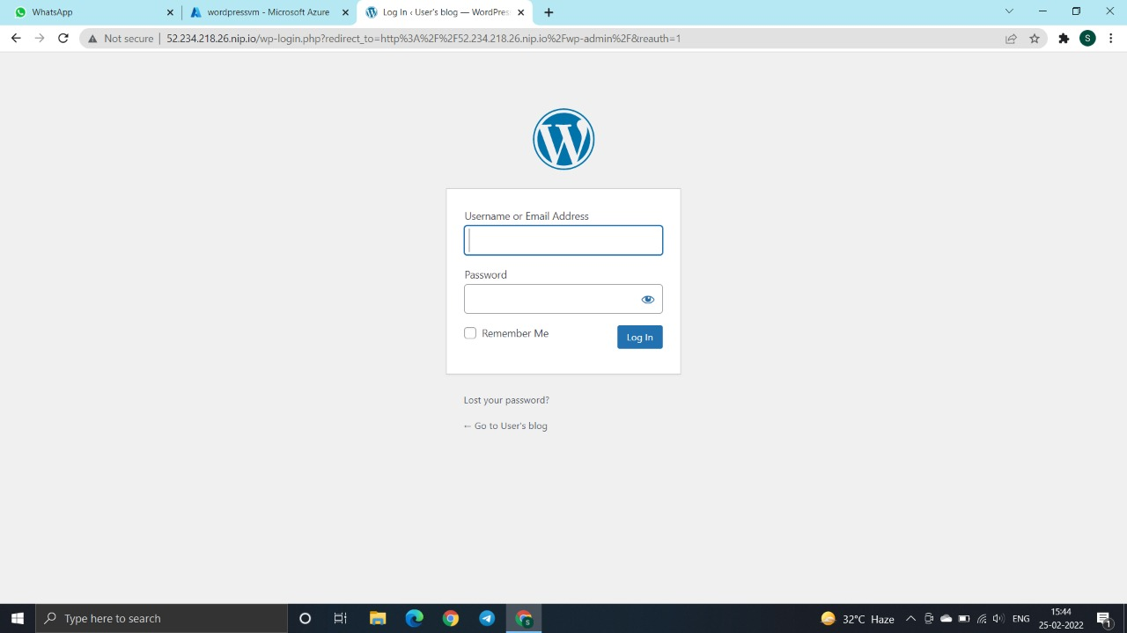
Login

Slide 8
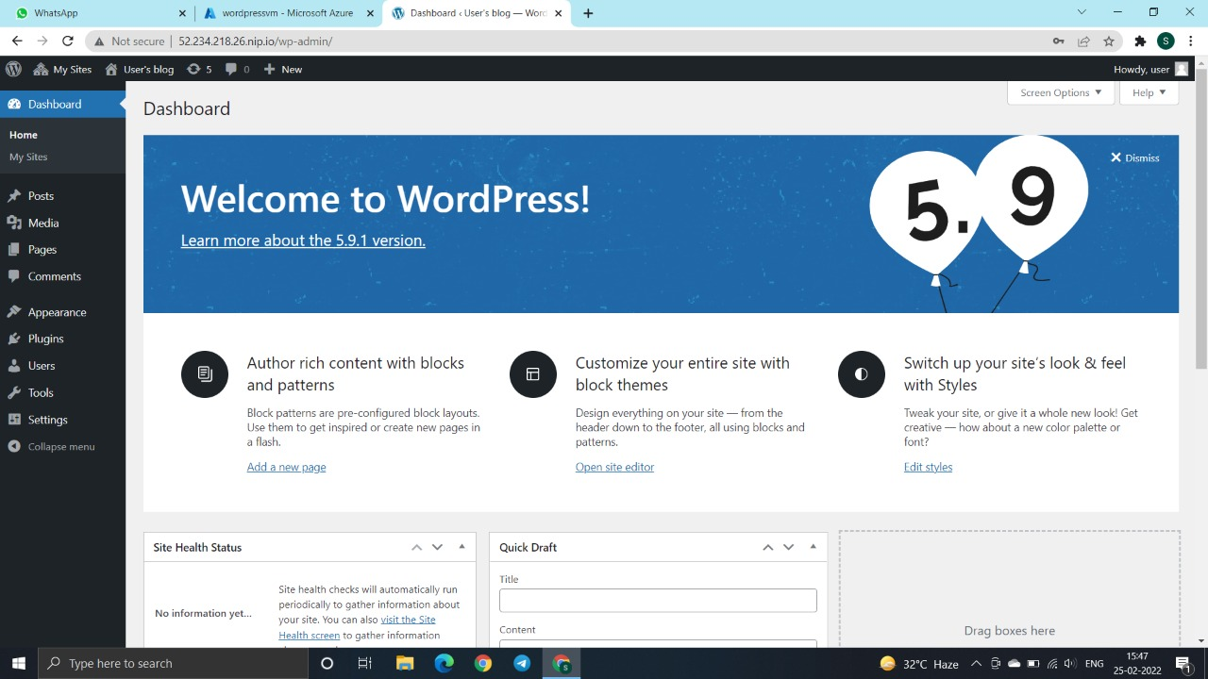
Dashboard

Slide 9
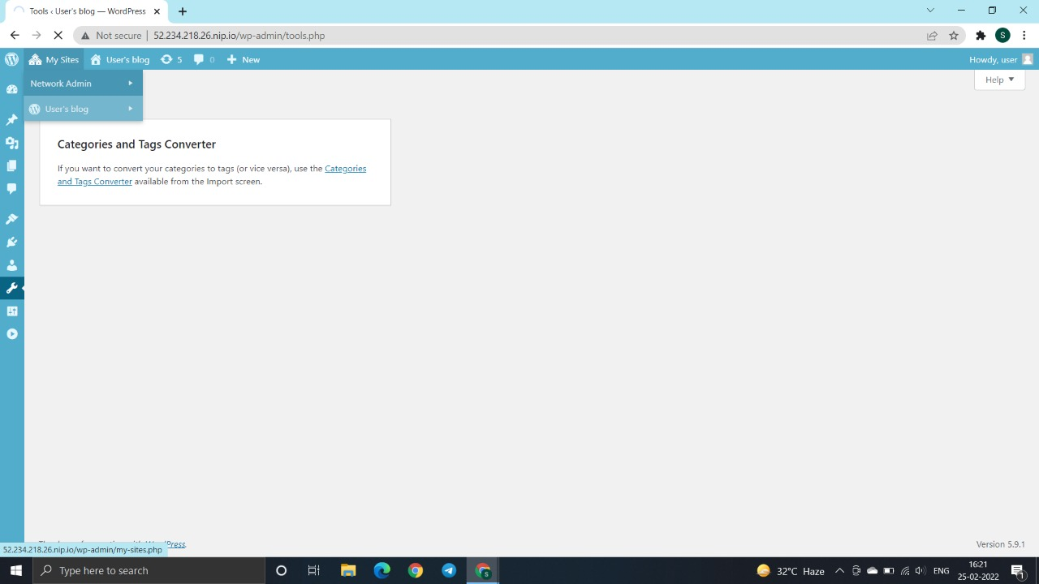
Admin & user blog

Slide 10
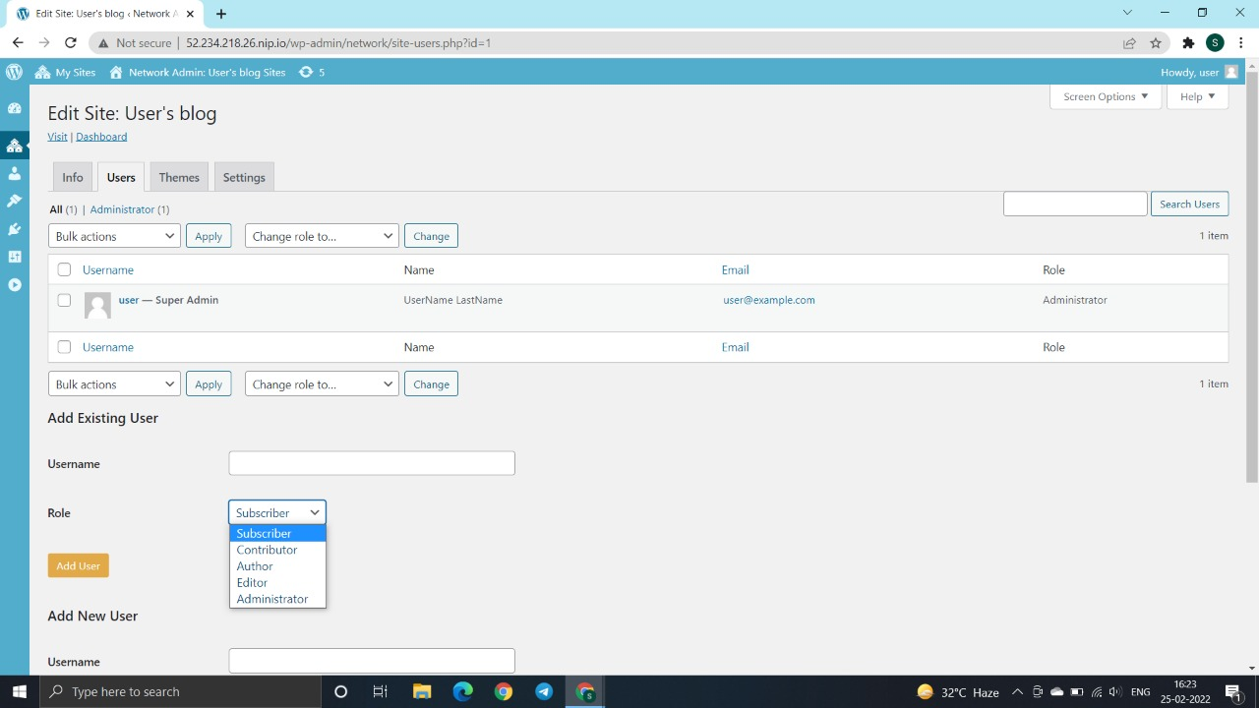
USERS

Slide 11
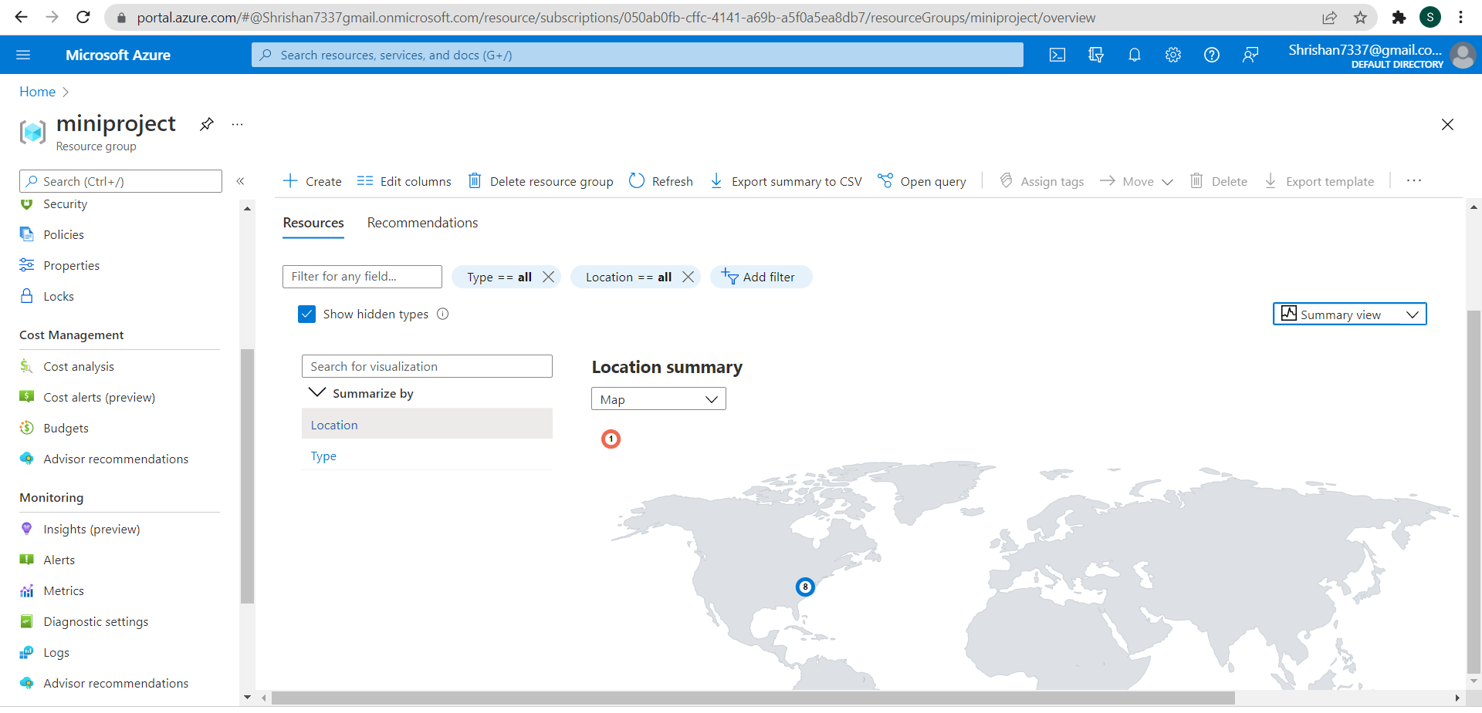
Location summary

Slide 12
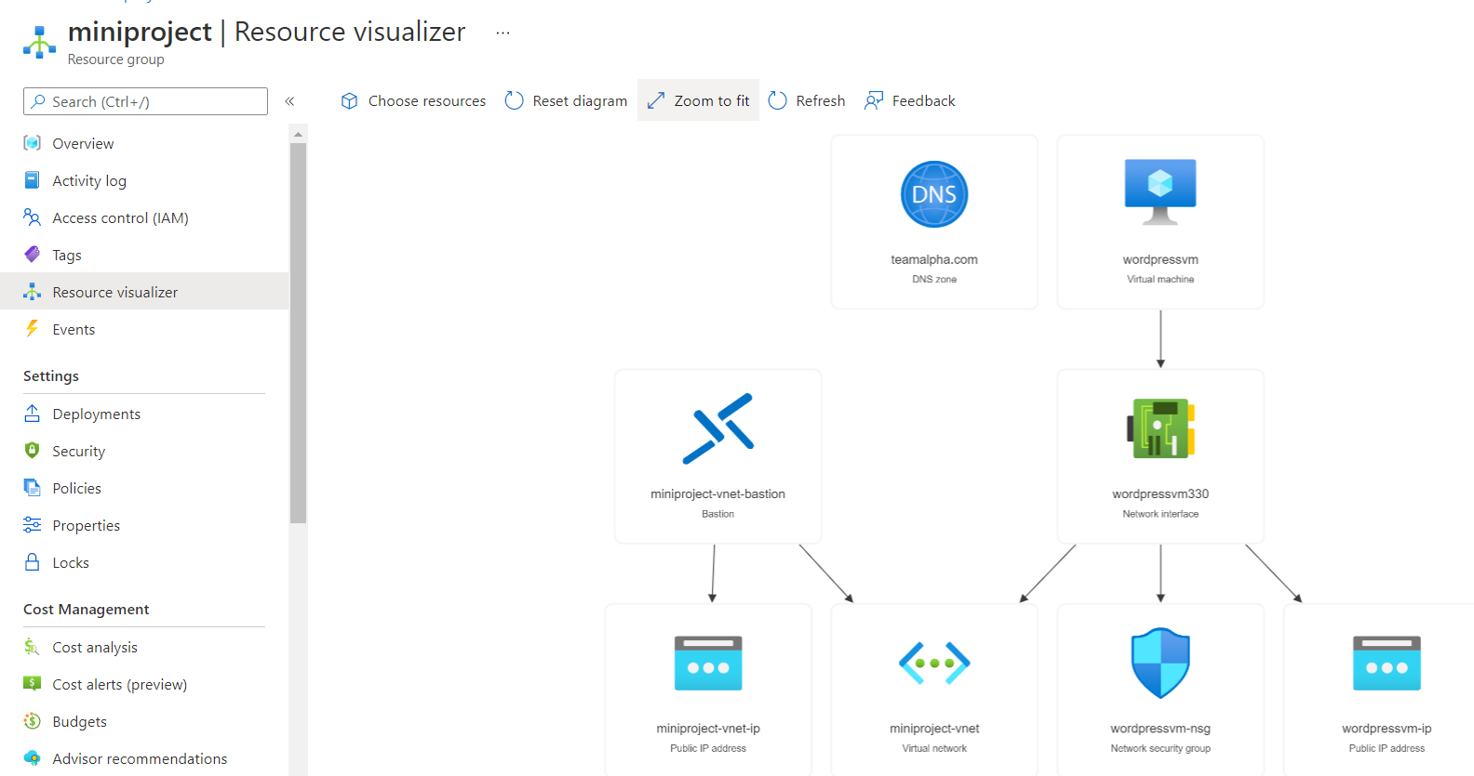
Resources

Slide 13
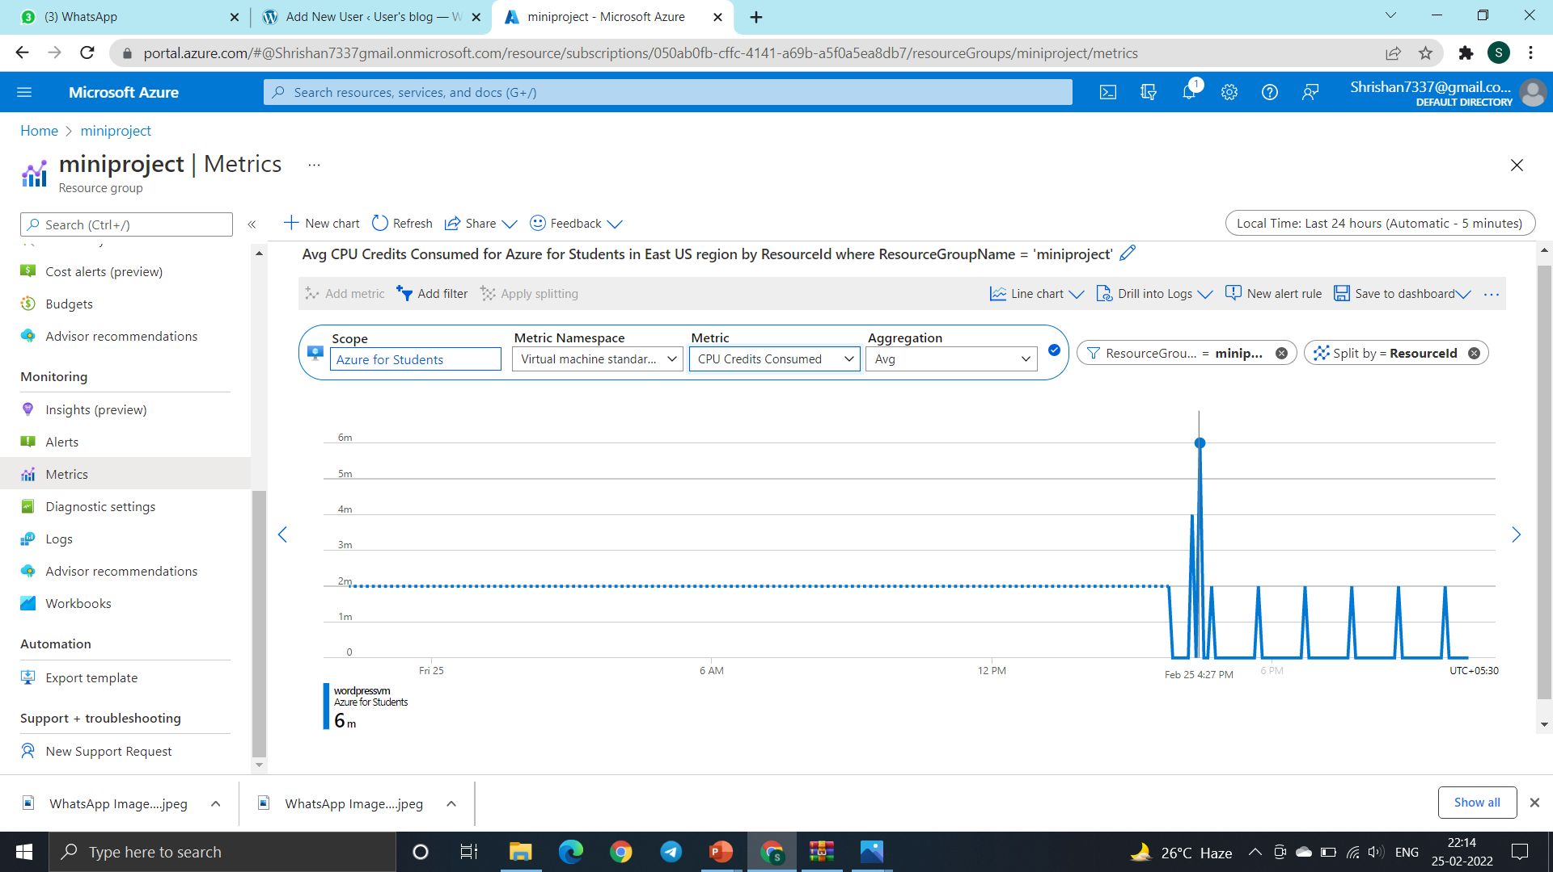
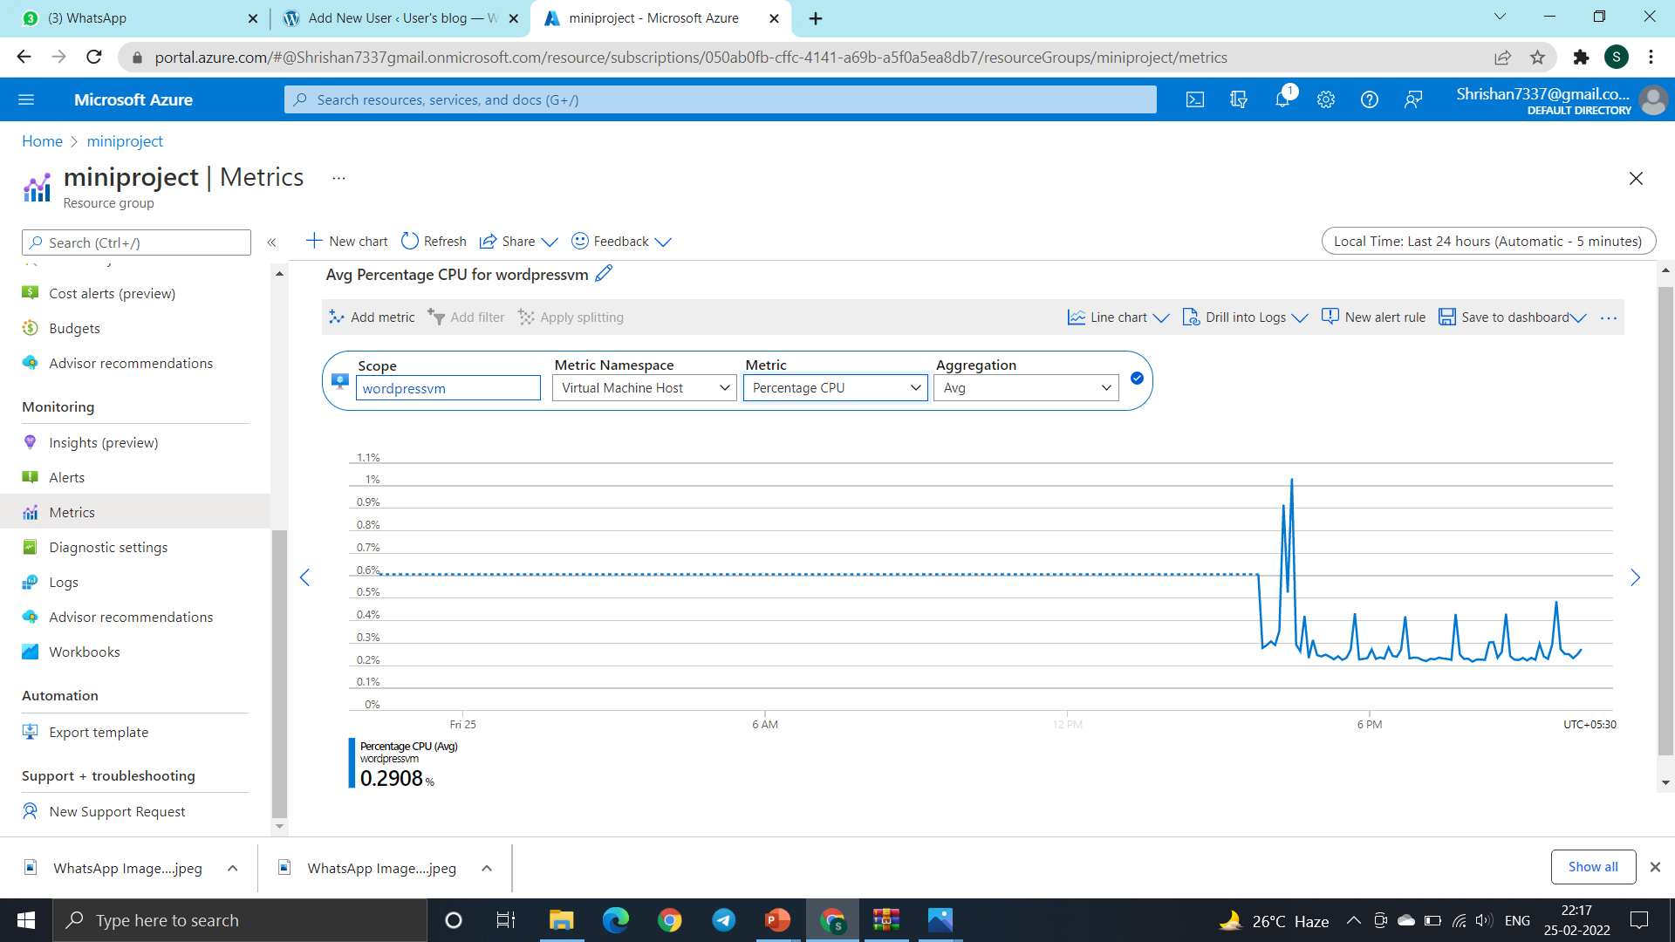
Metrics

Slide 14
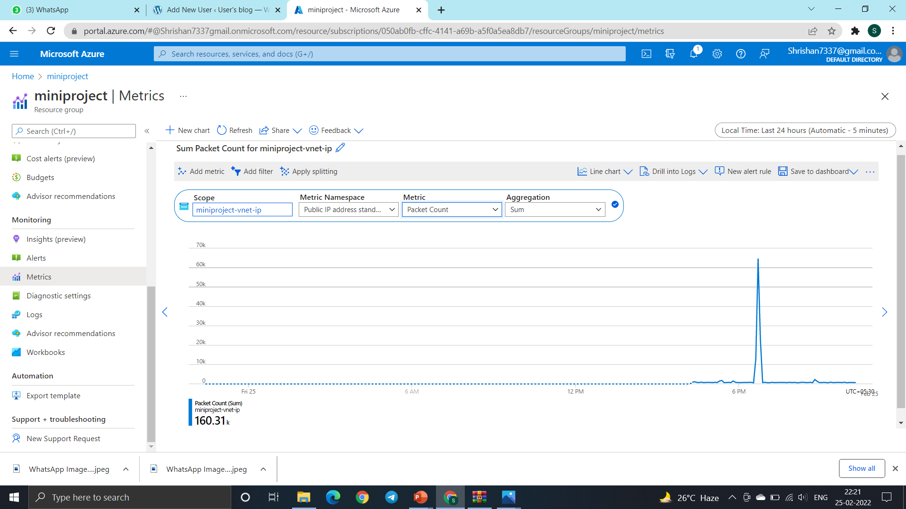

Metrics contd…

Slide 15
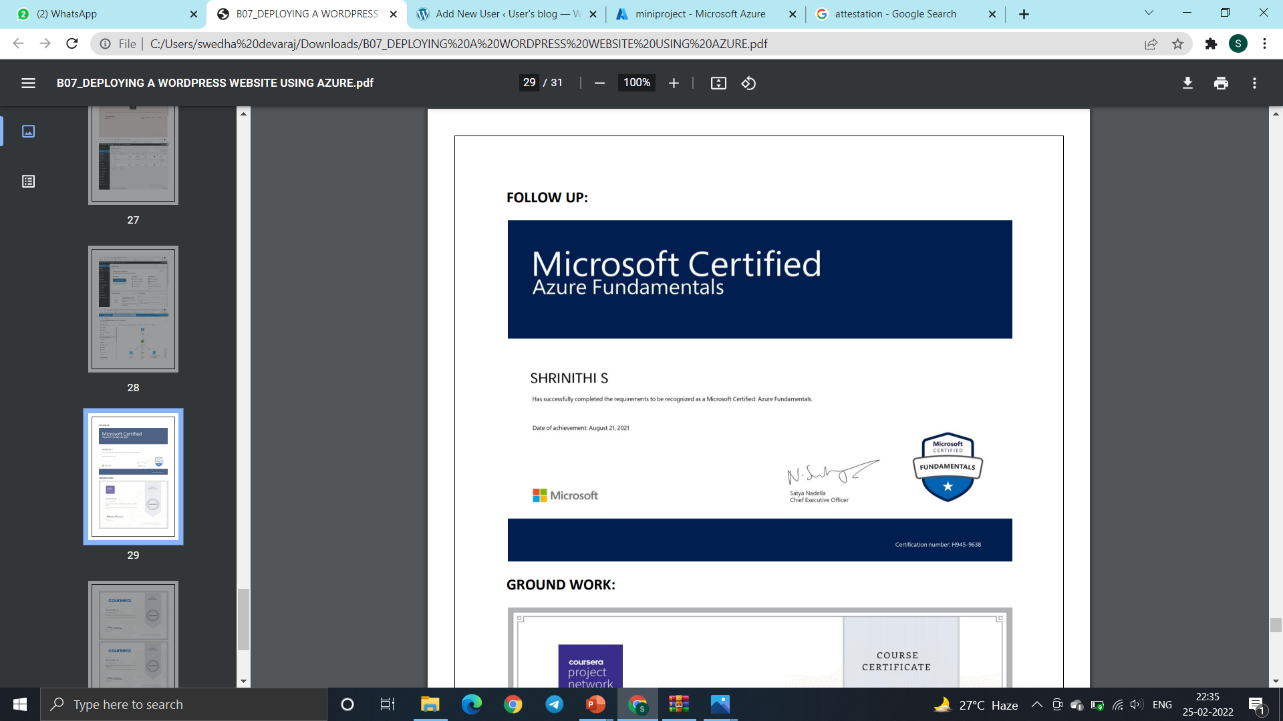
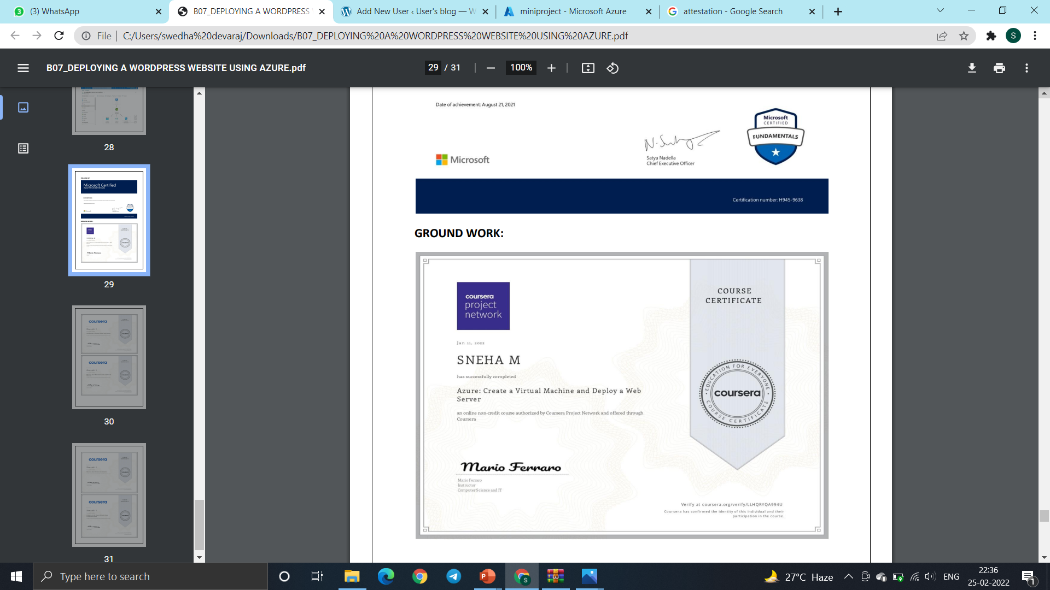
Attestation

Slide 16
Advantages
Easy deployment
pay-as-you-go-pricing
High availability
High scalability
Easy maintanence
Secure
Virtualisation
Hybrid cloud

Slide 17
THANK YOU

